Slide 1
Capstone Project – Northwind Traders Sales Analytics
Sales Analysis using SQL, Excel, and Power BI
By Pranathi NCH

Slide 2
Overview
The Northwind Traders Sales Analytics project focuses on creating an interactive Power BI dashboard that highlights key sales metrics, customer insights, and employee performance. It integrates SQL, Excel, and Power BI for end-to-end analysis and visualization.

Slide 3
Problem Statement & Objectives
• Analyze Northwind Traders’ sales data to identify performance trends
• Understand customer purchasing behavior and product profitability
• Evaluate employee efficiency and regional performance
• Provide a data-driven dashboard for decision-making

Slide 4
Data Sources & Preparation
Data was collected from SQL databases and Excel sheets containing Orders, Customers, Employees, and Products.
Key Steps:
• Removed duplicates and missing values
• Formatted dates and currency fields
• Built relationships in Power BI
• Ensured consistent naming conventions

Slide 5
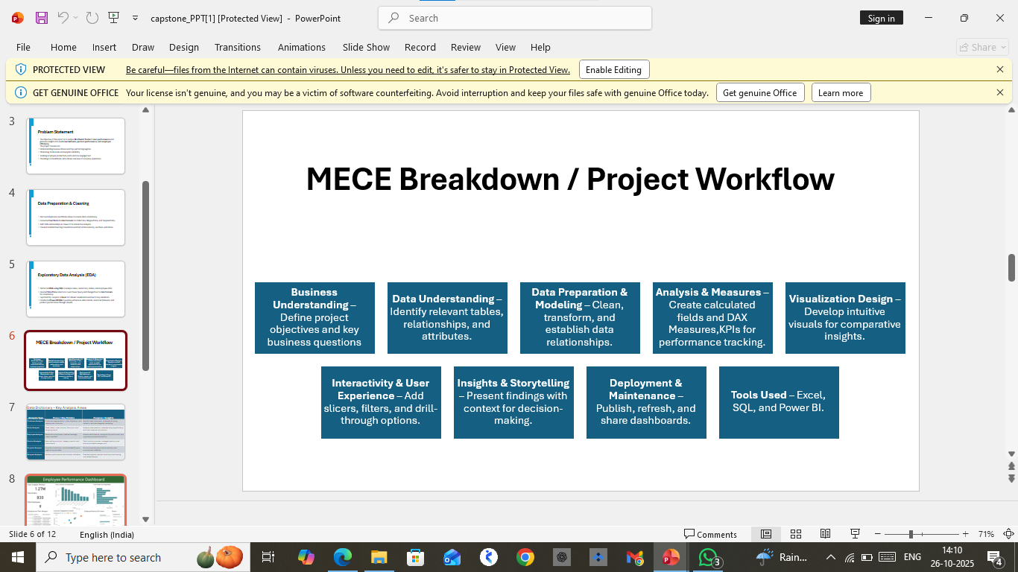

Slide 6
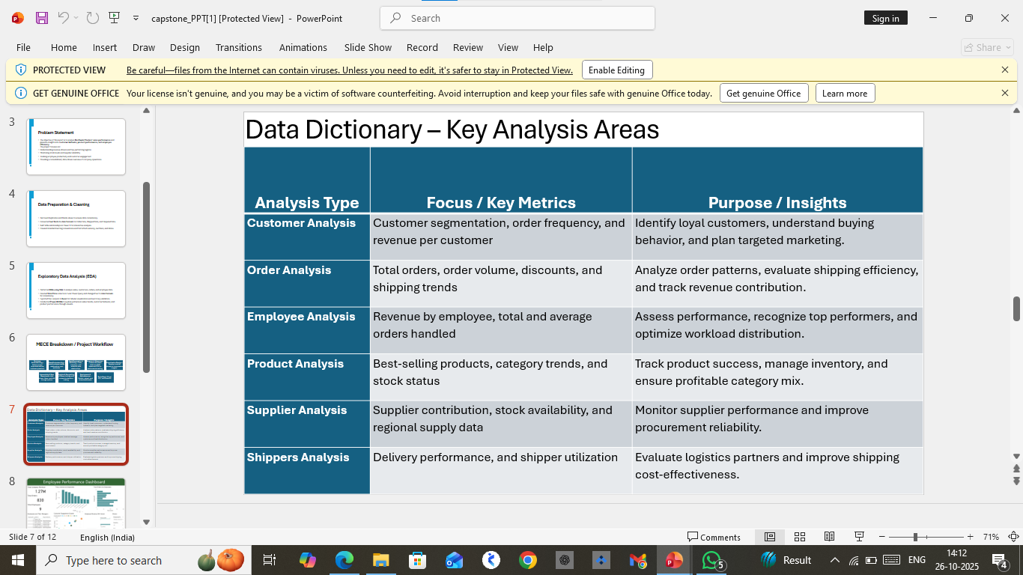

Slide 7
Exploratory Data Analysis (EDA)
EDA was conducted using SQL queries to explore sales volume, customer count, and order frequency.
Created Total Price column in Excel Power Query and changed text to date formats for consistency
Exported SQL outputs to Excel for tabular visualization and summary valiadation.
Conducted Power BI EDA to explore patterns in sales trends, customer behaviour, and product performance through visuals.

Slide 8
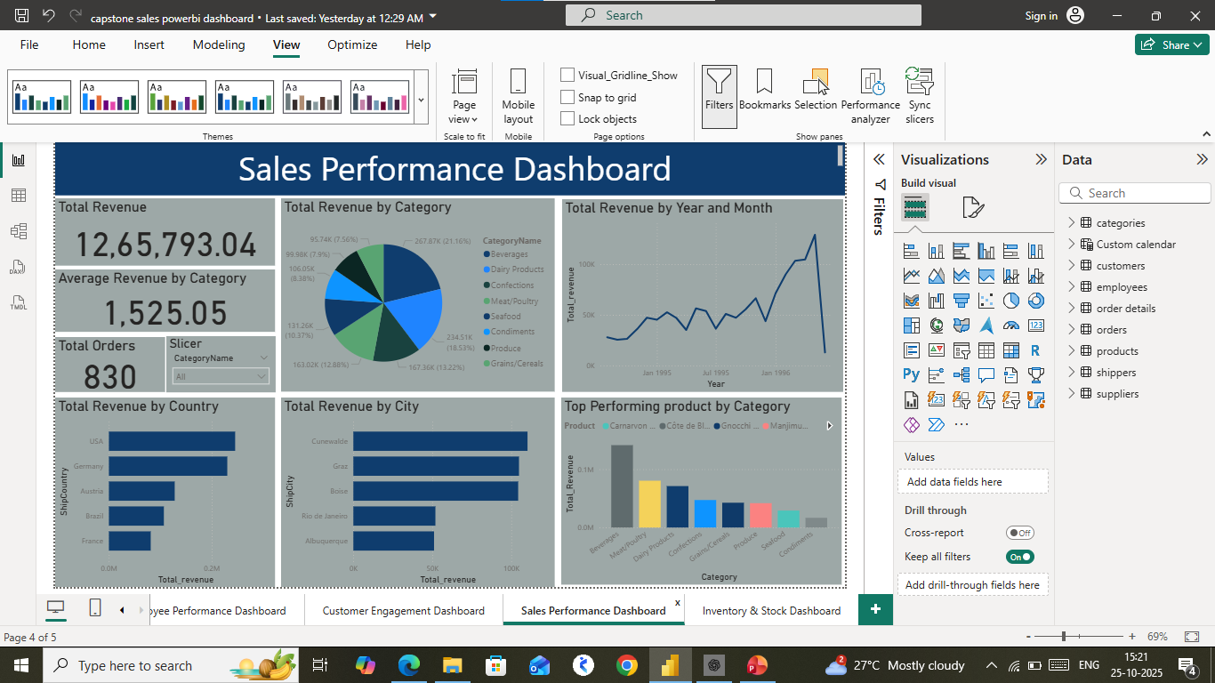
Sales Performance Dashboard (Power BI)
Power BI visualized key metrics such as total revenue, sales trend, and product category performance.
KPIs:
• Total Revenue: 12,65,793.04
• Total Orders: 830
• Average Revenue by category 1,525.05

Slide 9
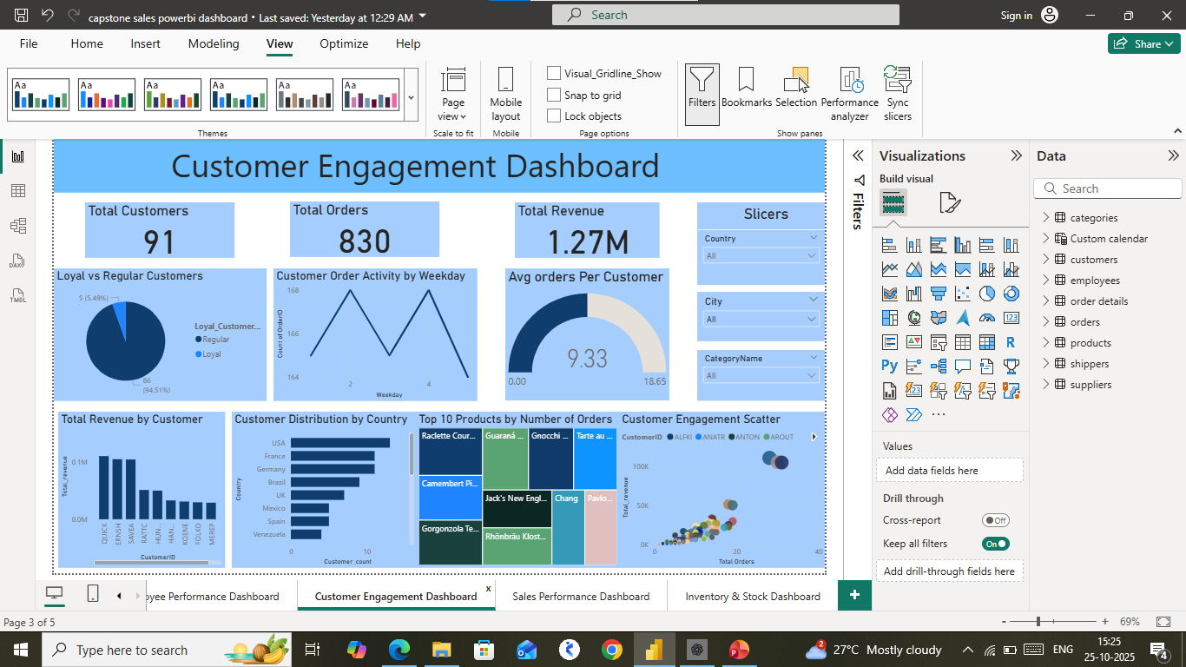
Customer & Product Insights
Customer segmentation identified top buyers and repeat customers.
Product-level analysis showed 'Beverages' and 'Confections' leading in sales.
Insights:
• 20% of customers contributed to 60% of revenue
• Discounts drove higher order frequency

Slide 10
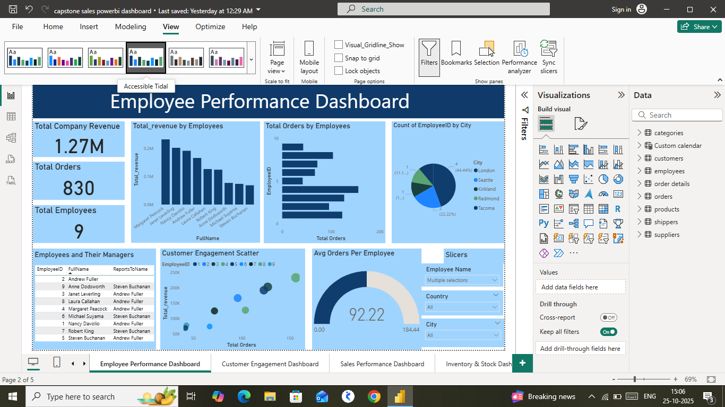
Employee & Regional Analysis
Performance metrics were compared among employees and across regions.
Findings:
• Top 3 employees contributed to 50% of total sales
• West Europe and North America regions had the highest average order value

Slide 11
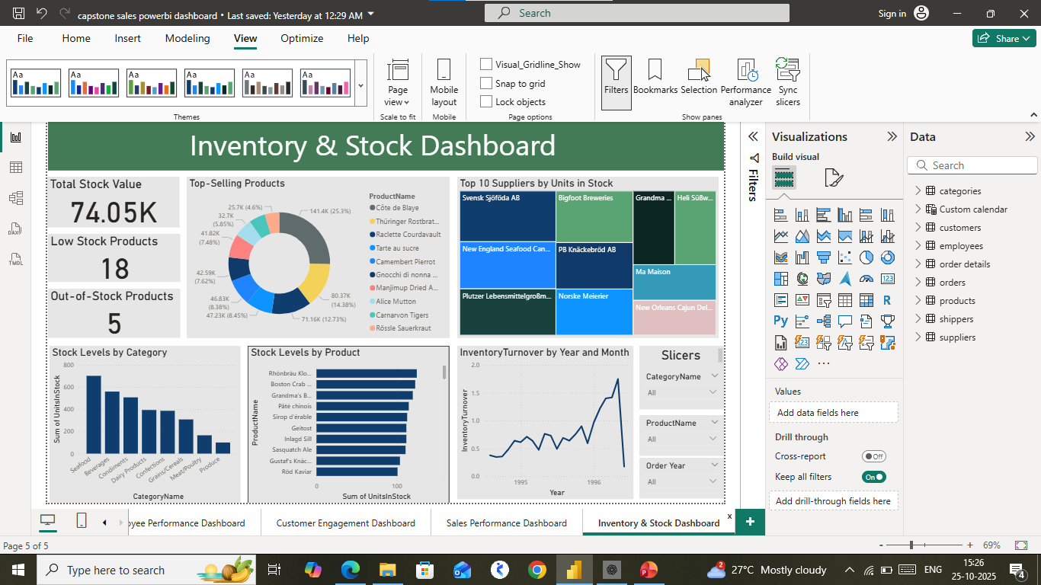
Inventory & Stock Analysis

Slide 12
Conclusion & Future Scope
This project demonstrates how SQL, Excel, and Power BI can be integrated to deliver actionable insights.
Future Enhancements:
• Automate dashboard refresh with live database
• Add predictive sales forecasting
• Expand analysis to include supplier performance and inventory management

